Slide 1
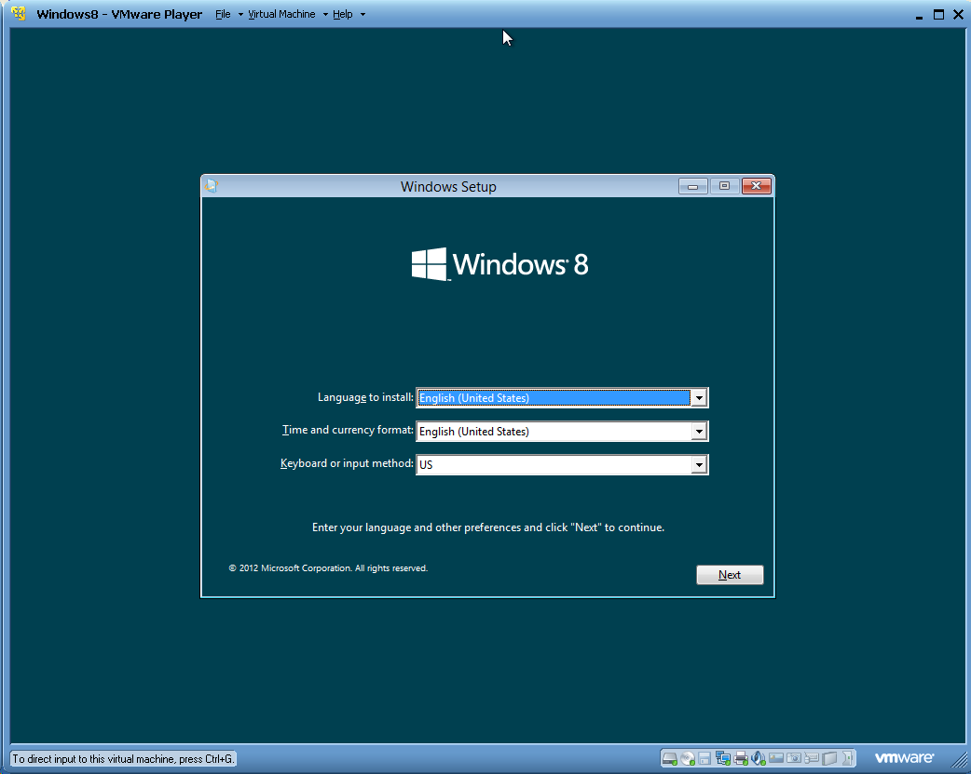
This Photo by Unknown Author is licensed under CC BY-NC-ND

Slide 2
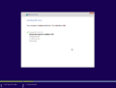
This Photo by Unknown Author is licensed under CC BY-SA

Slide 3


Setup is updating redgistery settings

Slide 4
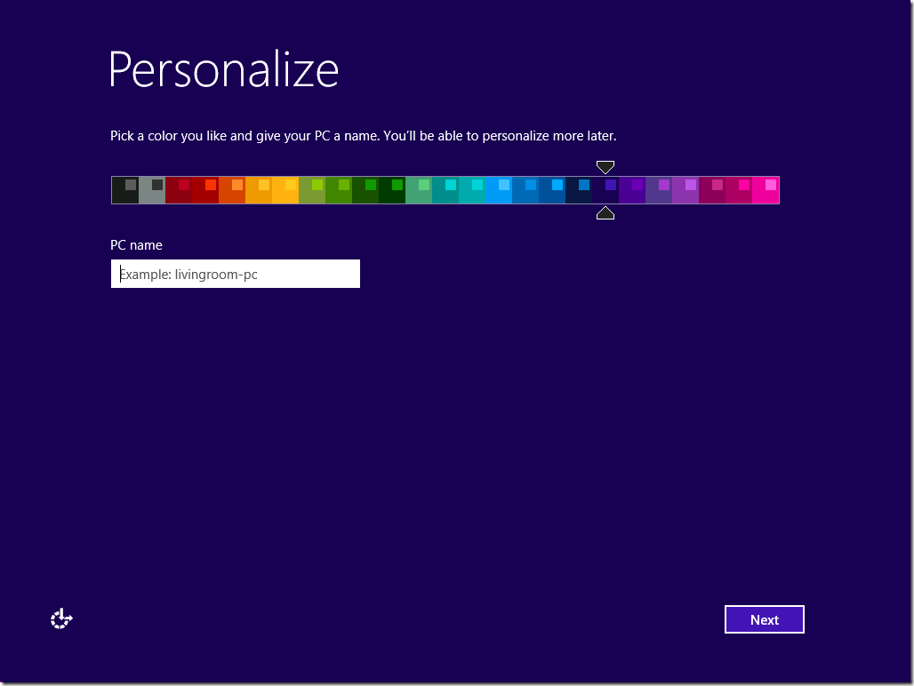

Slide 5
Loading.

Slide 6
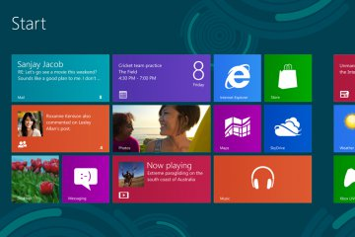

Slide 7
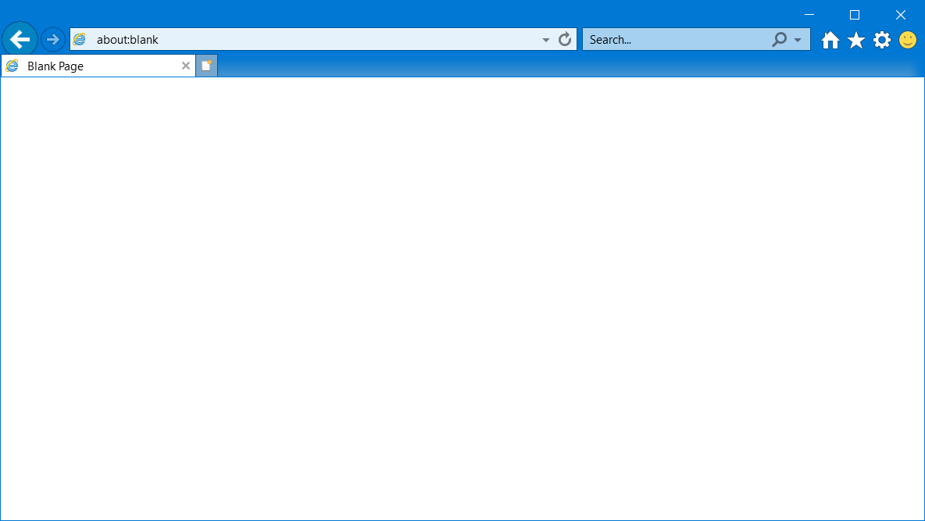
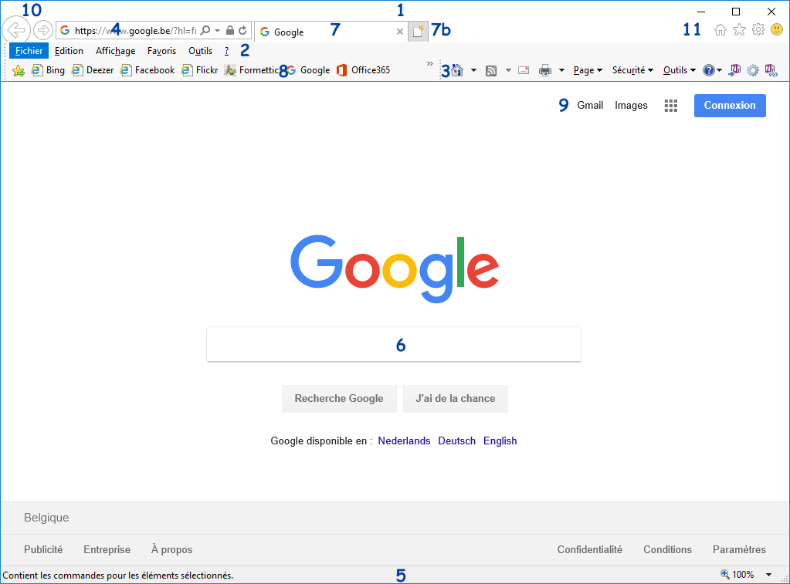
This Photo by Unknown Author is licensed under CC BY-SA

Slide 8
Roblox
This Photo by Unknown Author is licensed under CC BY-SA

Slide 9
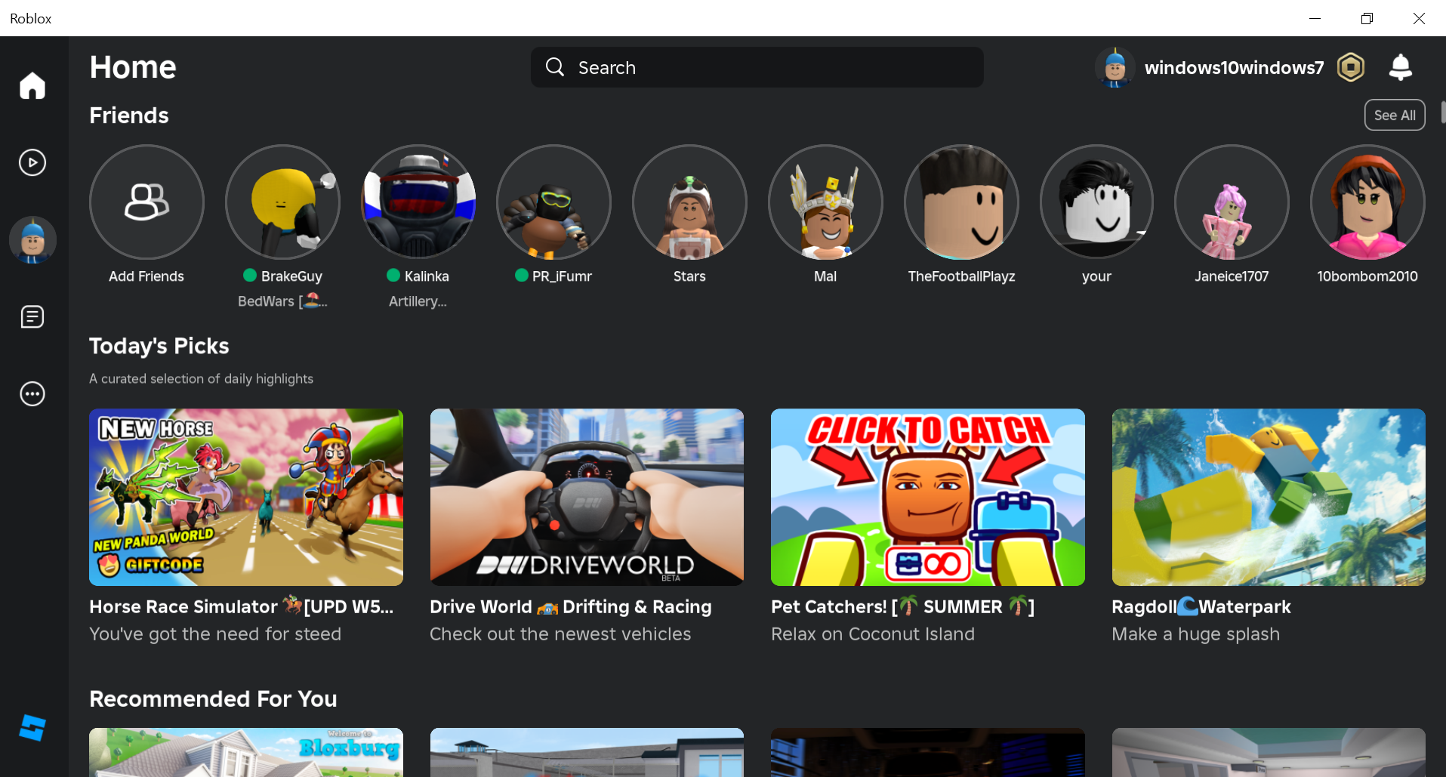

Slide 10
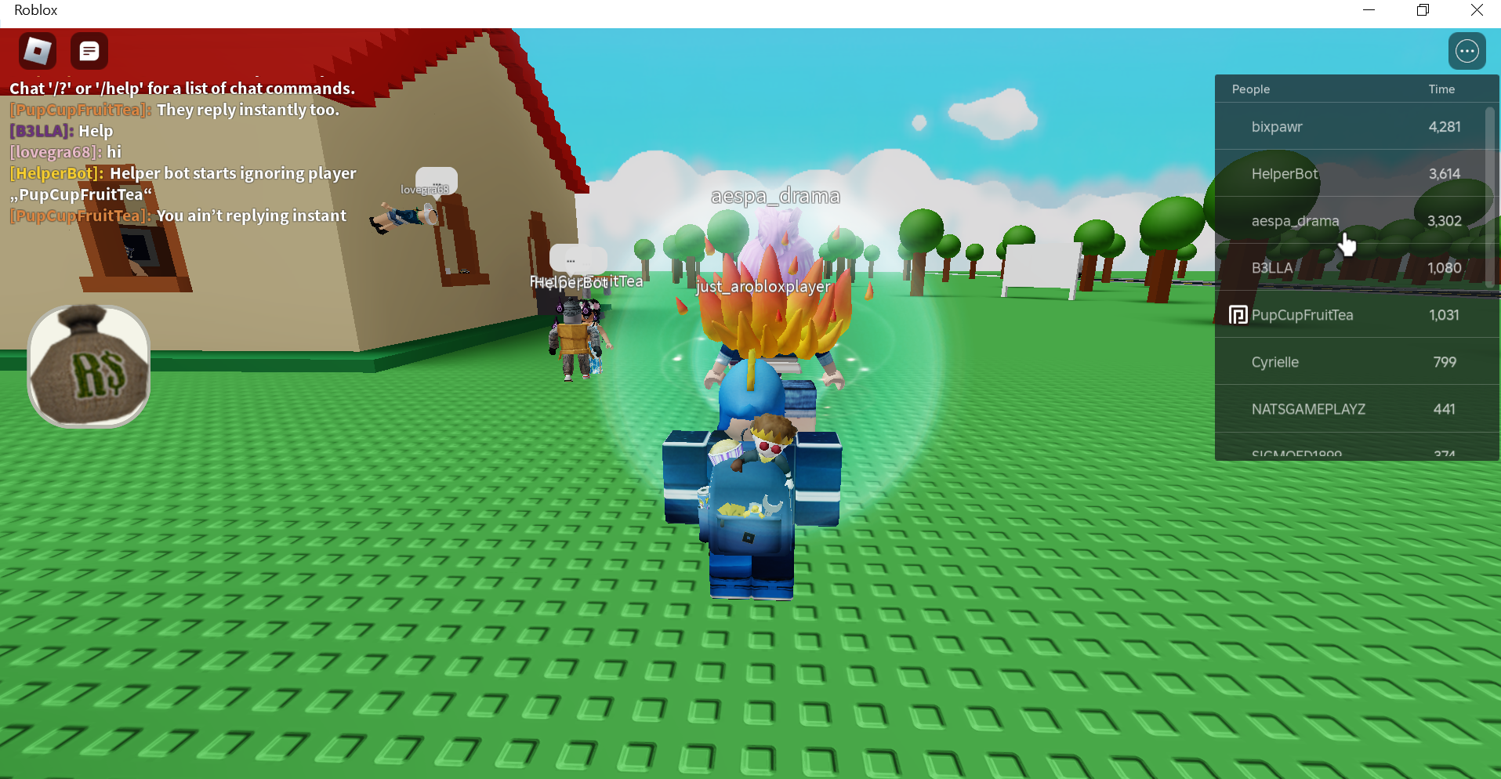

Slide 11
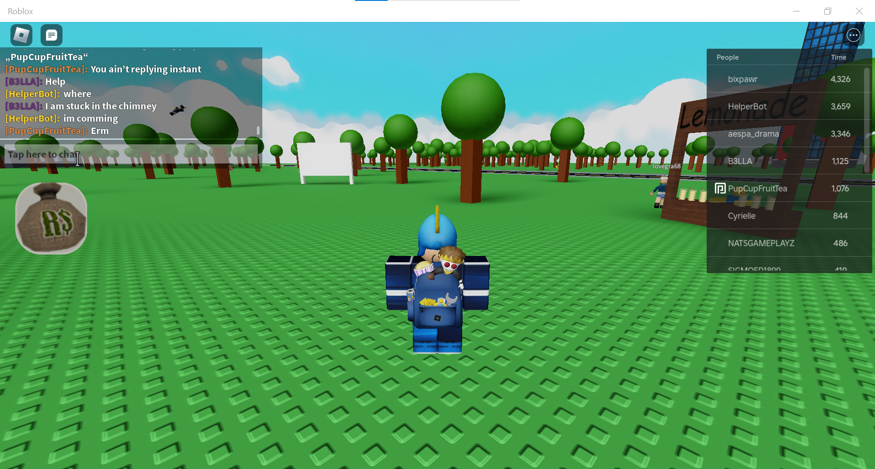

Slide 12
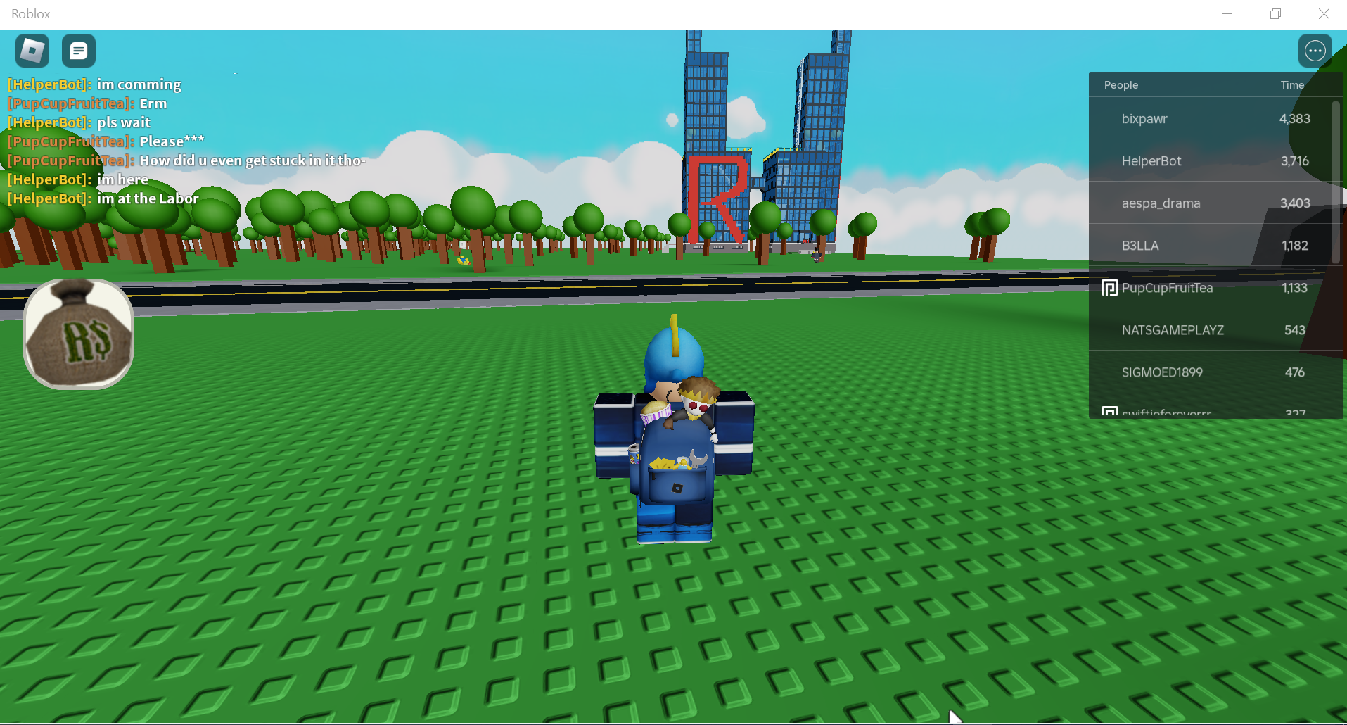

Slide 16
Windows is shuting down

